Slide 1
Six Nations Data
Jean-Pierre Viljoen

Slide 2
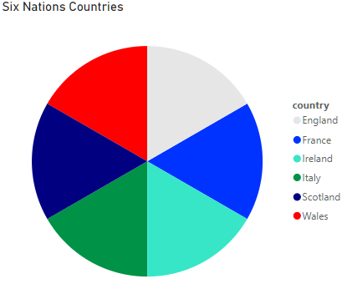
Who plays in the Six nations
The Six Nations Championship is an annual international rugby union competition between six European nations: England, France, Ireland, Italy, Scotland, and Wales. It is one of the oldest rugby championships in the world, tracing its roots back to the late 19th century.
Each team plays each other once during the tournament, with home and away fixtures alternating each year.
The championship typically takes place over the course of February and March, with matches held in the respective countries' stadiums.

Slide 3
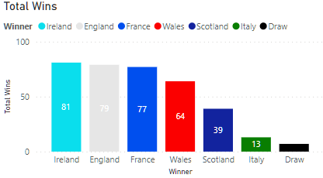
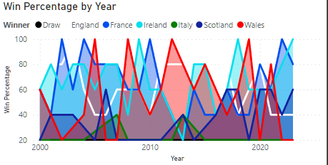
Historical Wins
As of 2023, Ireland are the Most Successful Six Nations Team with 81 wins followed closely by England and France.

Slide 4
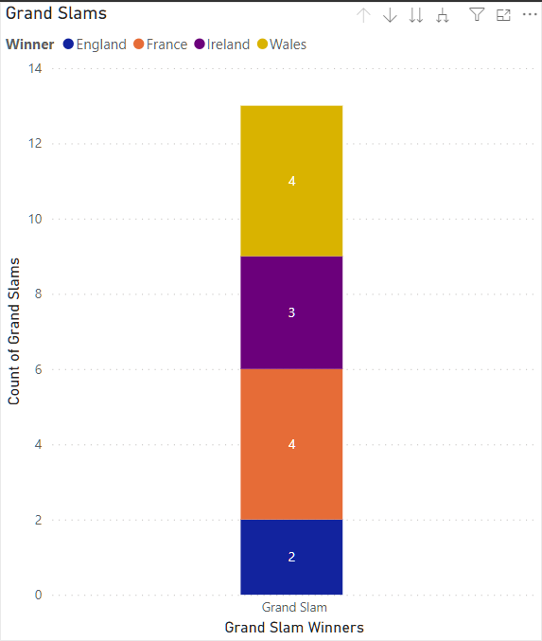
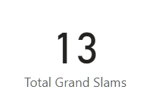
Grand Slams
A Grand Slam is a term coined for when a team wins the Six Nations with a 100% Win Record. Managing to beat all Six Nations opposition without any defeats. It’s clear as of between 2000-2023 this is a Rare Occurrence. This graph indicates the grand slam winners of the past 23 years, with France and Wales having the most Grand Slams.

Slide 5
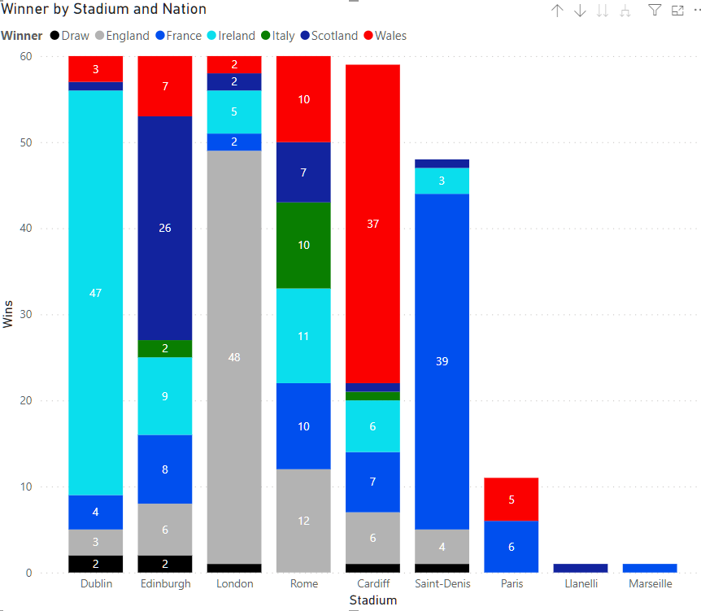
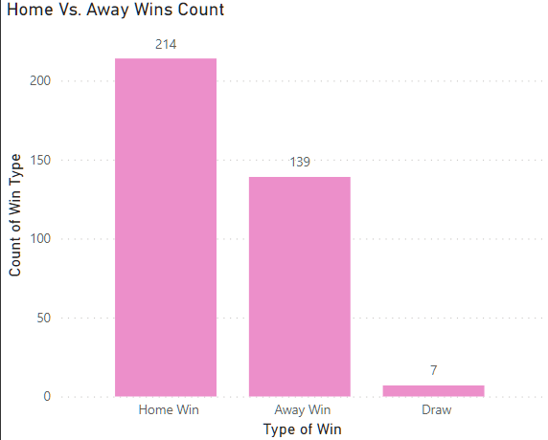
Home vs. Away Advantage?
The Data indicates a clear difference in Win rate if the game is a home game. This is further exemplified by the stadium statistics showing that Nations have the best win records at their own Stadiums. This is a factor teams need to consider when playing away games.

Slide 6
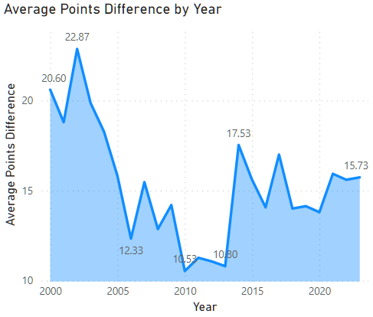
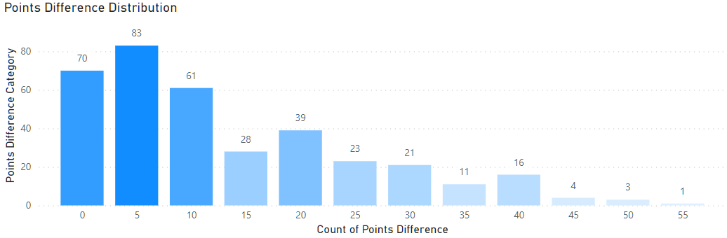
Points Difference & Trends
Between the Years 2000-2023 small trends developed indicating shifting Rugby Styles (Possibly Explained with World Rugby Rule Changes) With Average Points Difference in Six Nations Campaigns changing over time and a large drop after 2003.

Slide 7
Potential Future Investigations
Country GDP per Capita with Historic win rate.
Number of Active Professional Rugby Players per Nation.
Number of Rugby Playing Schools, Academies and Structures per Nation.
The Above may bring context to Nation win records allowing observers to understand why some nations may underperform (England) and Contextualise whether nations with low success like Italy are in fact Overperforming for their external constraints.

